Slide 1
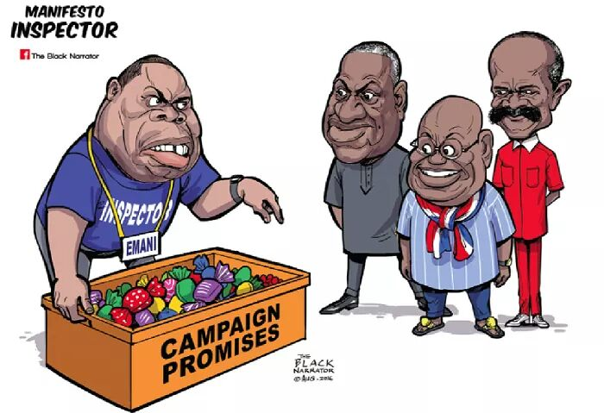

iMANIFESTO 2020 – A FINAL REPORT CARD ON THE DELIVERY OF THE NPP GOVERNMENT’S 2016 MANIFESTO

Slide 2
OUTLINE
Introduction
Methodology
Output-Based Performance
Economy
Human Capital Investment
Infrastructure
Governance
Social Sector
Overall Performance

Slide 3
INTRODUCTION
An outstanding feature of democracy is that the power to rule lies with the people.
Manifestos provide an avenue to make promises or proposed policies and interventions clear to the electorates in order to win their votes.
Manifestos can provide tangible means for voters to assess the capabilities of parties or could be a source of grandiose aspirations aiming to attract as many voters as possible.

Slide 4
INTRODUCTION
Since 2008, IMANI has been asking the business plans of political parties.
Over the past years, the feasibility of some promises have been questionable.
Dan Lartey’s $840bn annual GDP
Donkey dung for agriculture fertilizer project
In 2015, Imani presented a mid-term report card on the 540promises and a final report in 2016.

Slide 5
INTRODUCTION
Imani presented the first 100day assessment and first year report on the performance of the NPP.
The NPP government’s 2016 manifesto upon which Ghanaians gave them the mandate was dubbed, “Change: An Agenda for Jobs, Creating Prosperity & Equal Opportunity for All”.
This years’ iManifesto aims to provide an independent output-based assessment of the NPP government covering the period 2017-2020.

Slide 6
INTRODUCTION
This report card forms part of IMANI’s critical assessment of political parties’ manifestos which aims to achieve the following:
equip voters to make more informed political choice;
assist political parties to become more self-reflective and accountable
help political parties espouse more truthful and realistic political visions from the onset; and
to encourage both Ghanaian politicians and electorates to focus on issue-based elections rather than insult-based or ethnic-based elections.

Slide 7
METHODOLOGY
Content analysis and codification approach has been applied based on a 4-step procedure
Setting out the yardstick as the NPP’s 2016 manifesto
Identification of themes for formulating the framework
IMANI Manifesto Assessment Framework (IMMA)
Scoring and aggregation

Slide 8
METHODOLOGY
Multiple Data Sources
National Budgets (main and mid-year)
Annual Progress Reports
Parliamentary Hansards
Portals and Websites of Ministries, Departments and Agencies
News Articles and Reports
The team was very particular about reliability and validity of scores assigned

Slide 9
METHODOLOGY
The Organisation for Economic Cooperation and Development (OECD) developed a multi-dimensional framework with 11 dimensions (OECD, 2011).
ECONOMY 1. Income and Wealth 2. Jobs and Earnings
HUMAN CAPITAL INVESTMENT 3. Health Status 4. Education and Skills
GOVERNANCE 5. Civic engagement and governance 6. Personal Security
SOCIAL 7. Subjective well-being 8. Social Connections
9. Work and life balance
INFRASTRUCTURE 10. Environmental quality 11. Housing conditions
Notes:
Summary of literature that justifies the 5 themes that have been chosen, the weights, why we are using this method in of itself.

Slide 10
METHODOLOGY
Empirical evidence from the development and political economy literature shows the relevance of the quality of governance and a resilient economy to the well-being of people (Acemoglu & Johnson, 2005; Fosu, Bates, & Hoeﬄer, 2006; Helliwell, Huang, Grover, & Wang, 2018). These two are necessary for investment in education, social intervention and infrastructure to be sustained.
Also, infrastructure development is vital for economic growth to translate to economic development. As such, governance and economy are of most importance in the framework followed by infrastructure development. This informed the determination of the weight diﬀerentials.
Notes:
Summary of literature that justifies the 5 themes that have been chosen, the weights, why we are using this method in of itself.

Slide 11
METHODOLOGY
The assessment is along five (5) key themes which defines five (5) key variables. A simple weighted average score is constructed as follows:
        Eqn. 1
        The weights are assigned based on the consideration of various studies, including the eleven (11) dimensions of well-being as stated in the compendium of OECD well-being indicators (OECD, 2011).

Slide 12
METHODOLOGY
Theme | Sub-theme | Manifesto Promise | Is it implemented? If yes, assign 1 ; if no, assign 0; if partial, assign a fraction | Reason/Evidence for the assigned Score
Theme 1 | Economy | Achieve double digit GDP growth annually for the next four years | 0 | The GDP growth of Ghana has been 8.5% in 2017, 6.3% in 2018, 6.7% in 2019 and projected to be below 2.0% in 2020
Theme 2 | Infrastructure | The National Asset Protection Project | 0.5 | The finance minister in 2017 mentioned government's plans to ensure the protection of government's assets and ensure proper inventory on the asset. The NAPP as the project to deliver on this promise and the GIIF was the designated organization to implement the project. The Ghana Asset Management Corporation was developed in 2018 and approved by cabinet in 2019. The bill is set to be presented to parliament for its passage into law in 2020.
Theme 3 | Foreign Affairs | The NPP will play an active part in the effort to create the African Continental Free Trade Area (AfCFTA). | 1 | Under this administration Ghana successfully campaigned to host the continental secretariat of the AfCFTA, thus ensuring that Ghana will play a pivotal role in the formation of the free-trade area.
Notes:
Summary of literature that justifies the 5 themes that have been chosen, the weights, why we are using this method in of itself.

Slide 13
METHODOLOGY
Examples for the computations of the final score
        Eqn. 2
        This is interpreted on the scale as 100%
        Eqn. 3
        This is interpreted on the scale as 45%
        Eqn. 4
This is interpreted on the scale as 0%
Notes:
Summary of literature that justifies the 5 themes that have been chosen, the weights, why we are using this method in of itself.

Slide 14
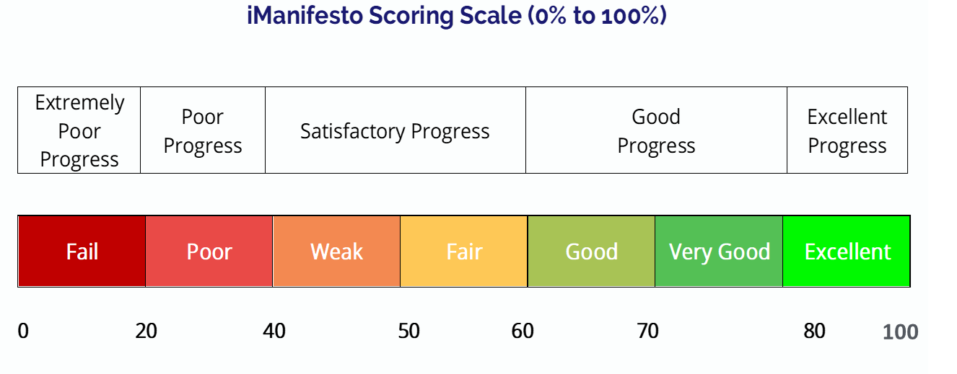
METHODOLOGY
Figure 1. iManifesto Scoring Scale
Notes:
Justification for this scale.

Slide 15
OUTPUT-BASED PERFORMANCE

Slide 16
ECONOMY (57.62%)
Overall, a total of 162 promises were made under the Economy sector.
87 under General Economy, Trade and Industry
54 under Agriculture
21 under Tourism
A total of 41 (25.3%) promises have been fully implemented, 101 (62.3%) partially implemented and 20 (12.3%) not initiated.

Slide 17
Economy – Trade and Industry
(Fulfilled)
Abolish 1% Special Import Levy
Abolish the 17.5% VAT/NHIL on selected imported medicines, that are not produced locally
Abolish 17.5% VAT/NHIL on Financial Services
Pass the Fiscal Responsibility Law
The Fiscal Council has been established
Financial sector clean-up exercise has been carried out and further actions continue to date.

Slide 18
ECONOMY – TRADE AND INDUSTRY
(Partially and Yet to Be Fulfilled)
Achieve double digit GDP growth annually for the next four years
This has not been achieved
Minimize political patronage of state sponsored microfinance institution.
Facilitate the passage of a Consumer Protection Law
This law has not been passed
Reduce the corporate tax rate from 25% to 20%
This is yet to be done

Slide 19
ECONOMY, TRADE & INDUSTRY – (52.53%)

Slide 20
ECONOMY – Tourism, Culture & Creative Arts
(Fulfilled)
Establish a creative arts fund.
Create a Division at the High Court focused on creative arts.
Promote literature, arts, dance and music across the country.
Pursue a deliberate marketing strategies to promote unique historical sites.
Improve professionalism and capacity of tourist staff and hospitality industry.
Transform Ghana Tourism Authority into a modern class promotion agency.

Slide 21
ECONOMY – Tourism, Culture & Creative Arts
(Partially Fulfilled/Unfulfilled)
Resource and reactivate Ghana Museums and Monuments.
Review and actively implement the Culture Policy.
Construct modern theatres in all the 10 regions.
Set-up copyright office in Takoradi, Tamale and Kumasi.
Actively promote the conservation of forest to support ecotourism.

Slide 22
ECONOMY- TOURISM, CULTURE & CREATIVE ARTS (73.81%)

Slide 23
ECONOMY – AGRICULTURE
(Fulfilled)
Ensure that farming inputs are readily available within farming communities at affordable prices
Fertilizer and seed subsidy program
Reactivate and expand the mass spraying and Hi-Tech programs
Cocoa mass spraying program
Reintroduce compensation payments under the cocoa disease control program
Initial treatment grant increase from GHS552.96 to GHS1000 per hectare
Revive the research program of the Council for Scientific and Industrial Research (CSIR)
Commitments in the budget

Slide 24
ECONOMY – AGRICULTURE
(Partially and Yet to Be Fulfilled)
Institute anti-dumping measures on poultry
There is no strong evidence to this promise.
Promote and incentivize research in using remote sensing and satellite imaging technologies to map soil properties nationwide
This is yet to be accomplished.

Slide 25
ECONOMY- AGRICULTURE (59.54%)

Slide 26
HUMAN CAPITAL INVESTMENT (55.87%)
Overall, a total of 63 promises were made under Human Capital Investment.
32 under Education
31 under Health

Slide 27
HUMAN CAPITAL INVESTMENT – EDUCATION (55%)
(Fulfilled)
Redefine basic education to include SHS, agricultural and technical schools, and make it available for free on a universal basis to all Ghanaians
This has been implemented
Restore trainee teachers allowance
This has been done
Restore the policy and additionally support Arabic/Islamic instructors with training and other incentives to motivate them to provide good training to our children.
- 3000 Arabic instructors have been recruited and deployed
Increase the amount of loan under the students loan scheme and streamline its administration.

Slide 28
HUMAN CAPITAL INVESTMENT-
EDUCATION
(Partially and Yet to Be Fulfilled)
Collaboration with the private sector, provide free WiFi coverage for senior secondary and tertiary institutions nationwide dedicated to learning, administration and enhancing the capacity to do research
This is yet to be fully achieved
Ensure that each region has two state-of-the-art technical and vocational institutions
This is yet to be fully implemented

Slide 29
HUMAN CAPITAL INVESTMENT -Education

Slide 30
HUMAN CAPITAL INVESTMENT – HEALTH (56.77)
(Fulfilled)
Reviewing and restructuring the sources of funding, as well as the institutional arrangements for the management of the National Health Insurance Fund (NHIF)
Directing and strictly ceding all funds raised through the NHIA Levy into the NHIF
NHIL Amendment bill was passed in Parliament and a technical team was constituted
Restoring trainee nurses’ allowances in full
This has been restored

Slide 31
HUMAN CAPITAL INVESTMENT – HEALTH
(Partially and Yet to Be Fulfilled)
Implementing a comprehensive plan for the safe disposal of biomedical waste
Incorporating traditional medicine in the health delivery system
Working with the private sector to establish a world class Research & Laboratory Centre within a responsive National Laboratory System
Implementing a National Epidemic Response System
Working with the private sector to establish trauma centres within hospitals along the main highways, in order to facilitate medical treatment of citizens in cases of accidents

Slide 32
Human Capital Investment- Health

Slide 33
GOVERNANCE

Slide 34
Governance (59.25%)
Governance, Corruption and Public Accountability
Foreign Affairs
Security
Local Government
Chieftaincy, Religious Affiliation and Civil Society Organization
A total of 80 promises were made under the governance theme.
68 from broad governance activities
12 under Chieftaincy, Religious Affiliation and Civil Society Organization

Slide 35
Governance, Corruption and Public Accountability- 43%
Fulfilled
Yet to be fulfilled
Established the Office of special Prosecutor.
Ensure the passage of the Right to Information Bill.
Support the work of NCCE to sensitize citizens against corruption.
Implemented the findings of the Public Accounts Committee and has retrieved GHC97million between 2018 and 2019
30% of appointments are female
Amended the Criminal Offences Act to make corruption a felony.
Establish a website to support corruption reporting in accordance with the Whistle blowers Act 2006 (Act 720)
Set up a procurement audit unit at the Auditor General’s department.
Strict enforcement of PPA legislations.

Slide 36
Local Government – 37%
Fulfilled
Yet to be fulfilled
Review the local government service regime
Decentralize and equip the Land Valuation Board (LVB) to provide direct support to MMDA’s for revenue mobilization.
Strengthen the sub-structures of MMDA’s through capacity building and adequate resource allocation
Oversee the election of MMDCE’s
Strengthen the role of traditional rulers in the local government framework.
Upgrading the Tamale Institute for Local Government Service into a state of the art institution to train local government staff
Oversee the passage of the Municipal Finance Bill

Slide 37
Foreign Affairs – 79%
Fulfilled
Yet to be fulfilled
Participate actively in the creation of the Africa Continental Free Trade Agreement
Strengthen ties with friends from the International Organization of La Francophonie –signing of the language pact in 2018
Welcome back citizens in the diaspora
Facilitate linkages between ambassadors, high commissioners and MMDA’s
Improve Ghana’s position in regional markets and AU
Provide opportunity for citizens in the diaspora to participate in national discourse. Eg. Participation in elections, Representation of the Peoples Amendment Act has not been implemented due to lack of political consensus-EC.

Slide 38
Security – 72%
Fulfilled
Yet to be fulfilled
Implementation of the National Barracks Regeneration Programme
Provide extensive training in the area of crime, anti-terrorism, cyber crime
Support the Small Arms and Light Weapons Board
Build 2 new police training schools
Build two new police hospitals at Sunyani and Bolgatanga
Revamp neighbourhood watch schemes
Review the structure of recruiting personnel into the police service

Slide 39
GOVERNANCE – 59.25%

Slide 40
SOCIAL SERVICES

Slide 41
Social Services
Total promises under social services were 57
The government made 45 promises under
social interventions
12 promises were made to deliver sports development.
The Social Services cover;
Social Interventions
Sports Development

Slide 42
Social Services
Fulfilled
School Feeding Programme
Trained 34,000 caterers in food security, hygiene and child nutrition.
Caterers required to buy and use locally produced foodstuff
Women Empowerment and Children’s Right
Abolished the market tolls on kayaye
Trained 400 female head potters have been trained in pre-employment skills
Development of the 5-years strategic plan under the “operation leave the street
- 30% of appointments to be reserved for women. 94 out of 305 appointments were females.
Livelihood Empowerment Against Poverty
The adoption of new technology for targeting
Re-certification of current beneficiaries as part of plans to exit the programme.
Youth Development
- Implementation of the National Entrepreneurship Innovation Plan has trained youth in different areas of ICT.

Slide 43
Social Services
Partially Fulfilled/Yet to be fulfilled
Persons living with disability
Neglect of special training schools
Inability of persons with disability to benefit from Free SHS policy
Inability to fully implement LI’s to ensure effective implementation of Mental Health Act 2012, Act 846 and the Disability Act 2006, Act 715
Pensions & Aged
Issue freedom pass to aged to have free access to public transport
Children
Develop a district integrated social services programme
Youth Development
Youth development Authority

Slide 44
SOCIAL SECTOR (58.85%)

Slide 45
INFRASTRUCTURE

Slide 46
INFRASTRUCTURE (51.71%)
Energy
Structural Development
Lands and Natural Resources
Sanitation and Water Resources
Aviation
Railway Development
Ports and Harbours
Communication
Environment, Science and Technology
Total number of promises were 148

Slide 47
INFRASTRUCTURE
ENERGY

Slide 48
INFRASTRUCTURE – ENERGY (57.57%)
Fulfilled
End ‘Dumsor ‘ in the short term
Reduced Electricity Tarrifs
Technical Audits of PPAs
Developed Energy Sector Financial Restructuring and Recovery Plan
Licencing and bid rounds and implemented Petroleum Regulation

Slide 49
INFRASTRUCTURE - ENERGY
Yet to be Fulfilled
Increasing the share of renewables in the generation mix.
Ensure transparency in the tariff setting decision making, procurement of PPA and engagement with IPP’S
Expand TOR’s Capacity to refine domestically produced crude oil
Refine oil produced domestically
Independence of GNPC

Slide 50
INFRASTRUCTURE – ENERGY (57.57%)

Slide 51
INFRASTRUCTURE
STRUCTURAL DEVELOPMENT

Slide 52
INFRASTRUCTURE – STRUCTURAL DEVELOPMENT (51.26%)
Fulfilled
Automation and Expansion of Ports
Improved water quality
E-Government platform
Road expansion & Interchange
Expansion of network coverage through the GIFEC
Abolished 5% tax on real estate
Abolished 17.5% VAT on domestic airline services
National Housing Regeneration Programme

Slide 53
INFRASTRUCTURE – STRUCTURAL DEVELOPMENT
Yet to be fulfilled
Construct the Eastern Corridor
Register every Ghanaian
Renew Fuel Stations along highways
Development of light rail systems
Utilisation of the Boankra inland port
Improve road network to all government hospitals
Establishing a National Hydrology Authority

Slide 54
INFRASTRUCTURE – Structural Development (51.26%)

Slide 55
56.77%
Overall Performance
This signifies a fair satisfactory performance.

Slide 57
Overall Performance
The Current Performance of the NPP Government (56.77)

Slide 58
Contributors
Ivy Agyeiwaa Amponsah
Erzuah Nvidah
King Carl Tonam Duho
Dennis Asare

Slide 59
THANK YOU

Slide 60
www.imaniafrica.org/reports

